Slide 1

Streaming of Video Through S3,Cloudfront and Elastic Transcoder
Guided by:- Sandip Patel
Prepared by:-
ArjunBhojani (17DCS006)
Mishar Vadodaria (17IT124)

Slide 2
Project Description
Video on Demand on AWS automatically provisions the AWS services necessary to build a scalable, distributed video-on-demand workflow. The video-on-demand solution ingests metadata files and source videos, processes the videos for playback on a wide range of devices, stores the transcoded media files, and delivers the videos to end users through Amazon CloudFront.

Slide 3
Services
Services that we have used in this project are :
1) AWS Simple Storage Service.
2) Amazon CloudFront.
3) AWS Lambda.
4) Amazon Elastic Transcoder.

Slide 4
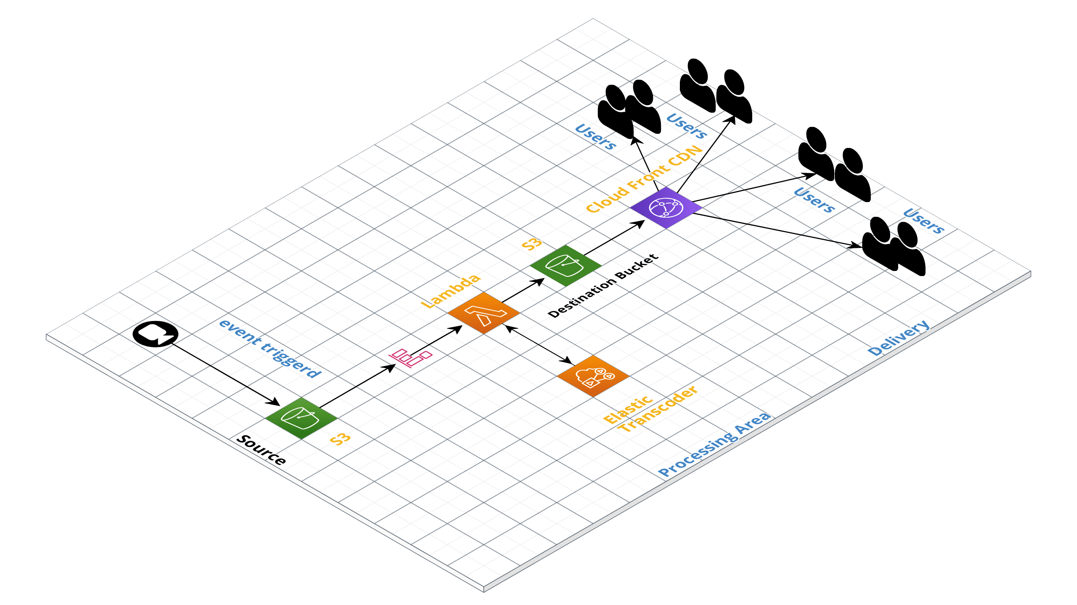
Architecture

Slide 5
AWS S3
Role of S3 in our project is to store the files that we are going to host and we are going to host static website through S3 only.
Why S3 and not EC2 Instance?
As we want to host static website we can host website through S3 with minimum cost of 1-3 dollars per month and that EC2 Instance cost 7-8 dollars per month.

Slide 6
Amazon Elastic Transcoder
Elastic Transcoder is used to convert the video in common format through which everyone can see the video through any browser or from any device.
Pipeline is created in which we specify from which bucket we want to take video and specify output bucket to which converted videos will be stored.

Slide 7
AWS Lambda
The main purpose of using the lambda function is to automate the task and also cost effective in compare to ec2 instances which further needs to manage by us.
Lambda function is to trigger the event when some action s performed so in this project additionally we use lambda function.
In the function we create the Elastic Transcoder Job through using SDK in which we specify which video will be converted in which format.
This Function is triggered only when we upload any video to Input bucket that we specified in pipeline through S3 management console.

Slide 8
Amazon CloudFront
It is Global Content Delivery Network through which our website will be available on the internet.
In CloudFront we have give origin to S3 bucket and root path given to our main home page of website through this we have to not given the public access to the S3 bucket in order to maintain privacy and security to the s3 content.
DNS that we get from CloudFront Distribution is used to access website through internet.

Slide 9
Conclusion
In this project we have host website without making S3 bucket public and automate transcoding of video using Lambda function.
At end of project we have learned many new concepts and practical implementation which will helped us to improve our skills and it had lead us to new way of learning the aws more and more.

Slide 10
Resources:
Aws architecture:
https://app.cloudcraft.co/view/a412b2eb-d984-43c5-a92d-f9b698c207ff?key=f_VwdPx6NKpj4_pu4V0Qpw&interactive=true&embed=true
Aws Console link:
https://362686975534.signin.aws.amazon.com/console
UserName:Sandipsir
Password: 7&o*Lb4!JP9

Slide 11

THANK YOU

